Slide 1

INSTALLATION OF SEWAGE TREATMENT PLANT IN YOKRI LIVING QUARTERS
November 24, 2016
Itene Richard
Asset Integration Support

Slide 2
OBJECTIVE
Seek NAPIMS Support/Approval for the Installation of waste Treatment Plant at
Yokri Flowstation
Seek Approval for Use of NAPIMS Contract NG01016589 for Execution of
this activity
Seek Approval to warehouse the charges on OPEX cost Centre 113066

Slide 3
BACKGROUND
The Yokri living quarters has three septic tanks that get filled most time and this
requires to be dislodged on two weekly basis.
The reason for this is that the living quarters is located close to the Forcados river and
the water level within the Yokri area allow for soak-away pits.
The living quarters has POB of 8, but hosts over 24 visitors on the average on daily
basis because of the helipad that is situated in Yokri.
The average cost of Logistic requirement for dislodging of the tanks is
N37,267,560 + $45,036 Yearly.

Slide 4
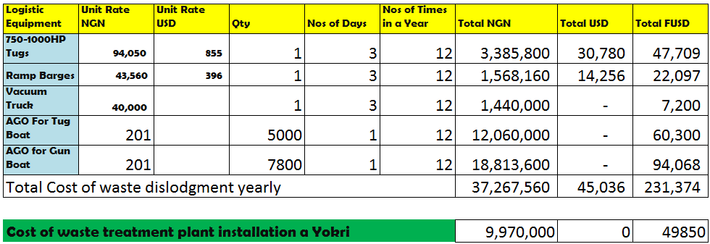
COST ANALYSIS

Slide 5
BENEFIT OF WASTE TREATMENT PLANT INSTALLATION
Installation of this treatment plant at Yokri if approved/support will reap the following
benefit:
Eliminate the cost of Logistic equipment circa F$230k yearly
Eliminate HSSE Exposure for Logistic Personnel on water (Security and other
Other water Transport related issues).
It will provide a cleaner environment conducive for habitation.

